Slide 1
ISE 305 Final Project
Andrew Ferruzza

Slide 2

Smaller Subset of An Actual Supermarket
Store – 11 entities
Department – 10-13 departments for each store, 151 entities
Product – 3 Products for each department, 240 entities
Customer – 25 entities
Employee- 55 entities
Transaction – 55 randomized transactions. 5 for each store, 55 entites

Slide 3
Supermarket Database Design
Tables:
Store (ID, storeLocation, storeAddress, storePhone, storeHours)
Department (ID, deptName, storeID)
Product (ID, storeID, deptCode, productName, price)
Transaction (ID, transDate, transTime, custID, storeID, employeeID, totalPrice)
Customer (ID, customerFirstName, customerLastName, customerPhone)
Employee (ID, storeID, deptCode, employeeFullName)

Slide 4
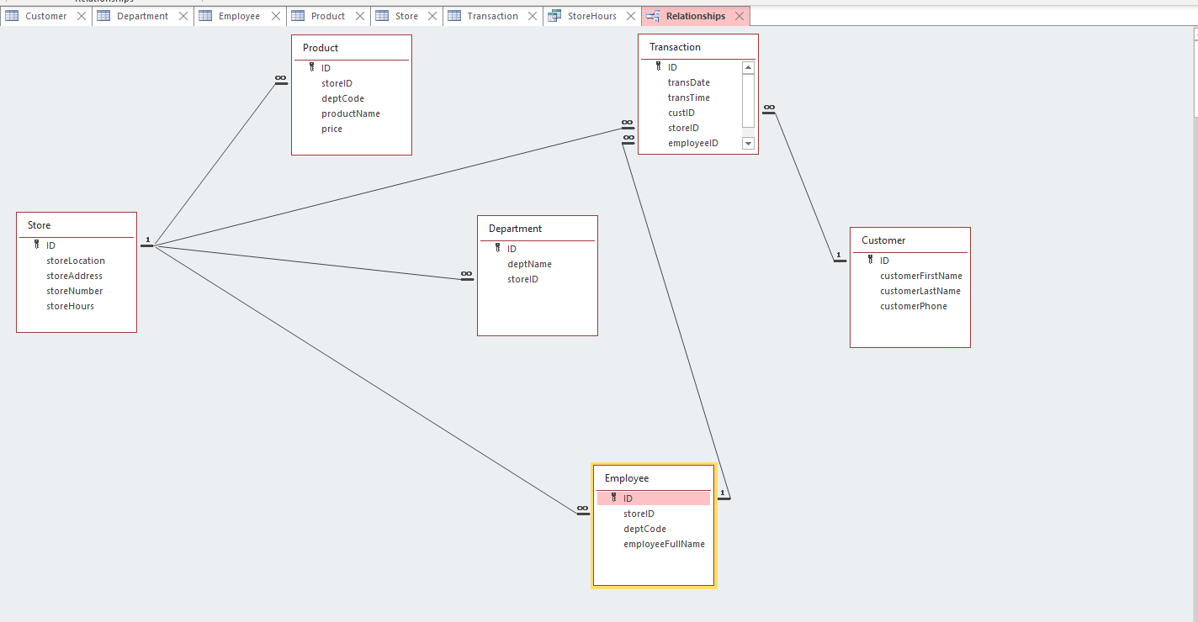
(Updated) RDM

Slide 5




Query #1-Highest customer purchases across all stores?

Slide 6

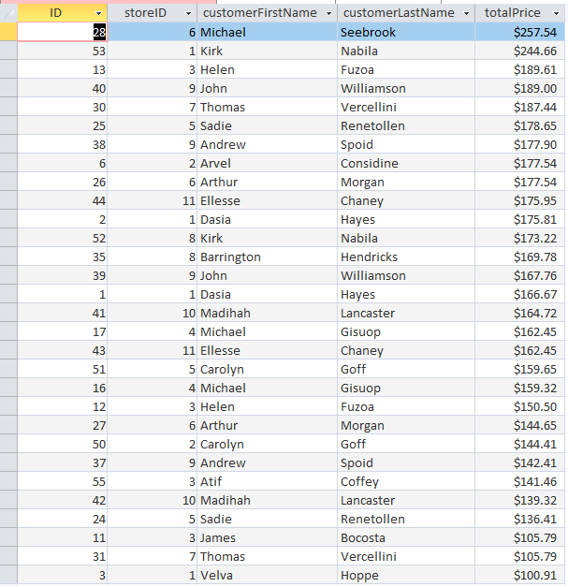

Slide 7
Query #2 – What were the total sales for the month of October (across all stores)?

Slide 8
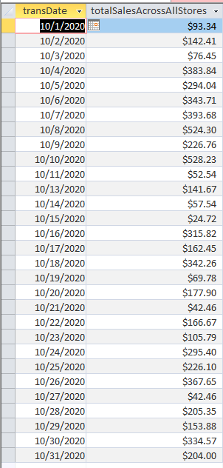


Slide 9
Query #3 – I want the lowest price pork and I don’t care what store it requires me to go to.

Slide 10

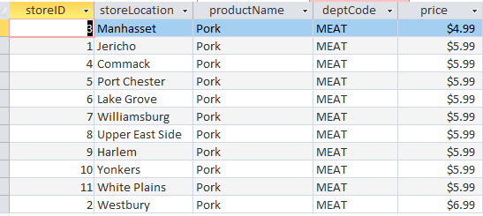

Slide 11
Query #4 – I am going shopping and would like to pick up a pizza or a salad after I shop. Can you query the stores that have EITHER of those?

Slide 12

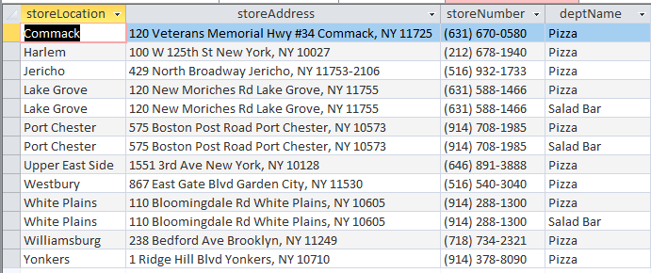

Slide 13
Query #5 – I like to go shopping in the 7:00 A.M. hour, and I would also like to pick up coffee at the store on my way out. Are there stores that meet BOTH of these desires?

Slide 14



Slide 15
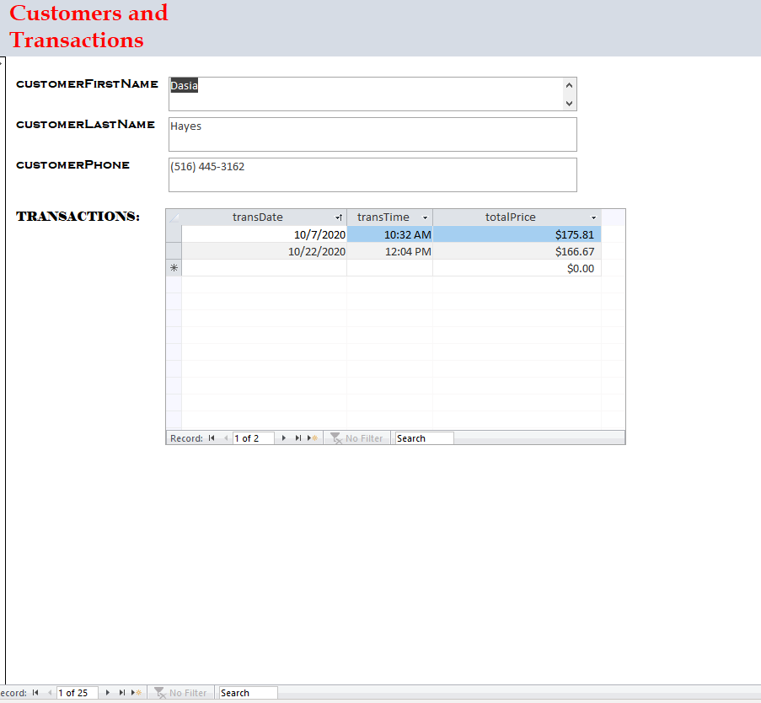
Form #1 – Customers and all their respective transactions

Slide 16
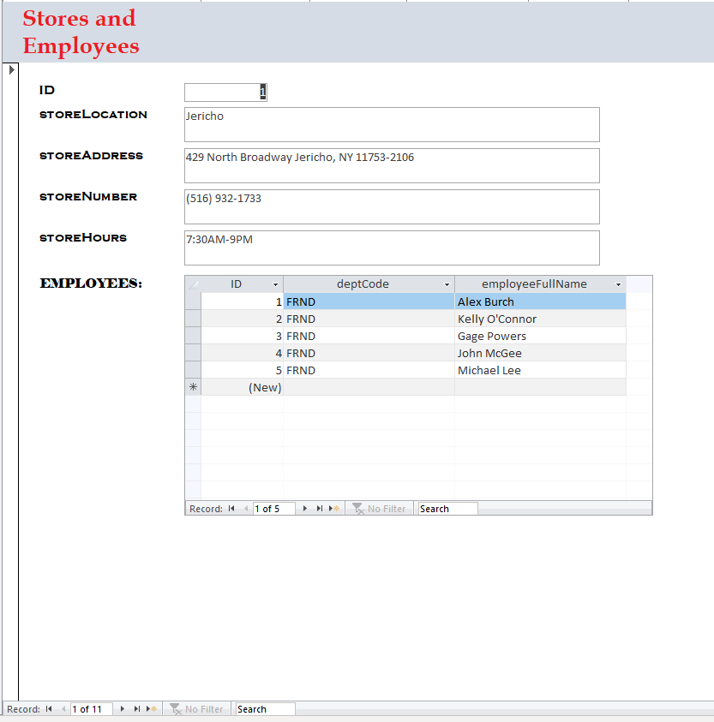
Form #2- Stores and their respective employees

Slide 17
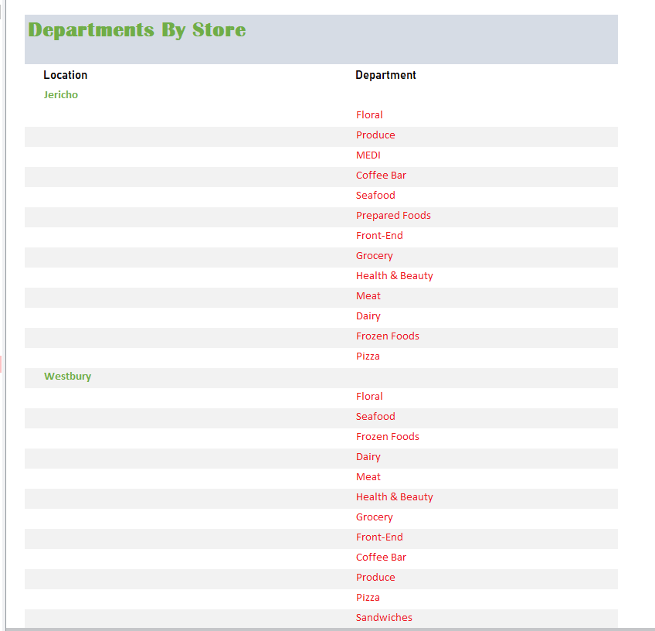
Report – All departments listed under their respective store

